Slide 1
//
AERO HACKATHON
Hackathon Take-Off:
Humans X AI
A one-day hackathon: build a simplified avionics system.
Humans powered with AI.
ASD · Skyline & Borg
Notes:
Welcome everyone, quick intro to the Humans X AI hackathon.

Slide 2
//
KICKOFF
Agenda
MORNING
AFTERNOON
09:00–09:30
Arrival: Boarding
13:30–15:30
Flight Block 2: Get It Flying
Check-in, merch, find your table.
Core challenge continues.
09:30–09:50
Pre-Flight Briefing
15:30–16:00
Final Approach
Welcome, challenge rules, theme reveal.
Wrap up code, finish docs, submit repo.
09:50–10:00
Crew Assignment
16:00–16:45
Show & Tell: Cockpit Demos
Teams pick their approach and assign roles.
Lightning demos from selected teams.
10:00–12:30
Flight Block 1: Build the Solution
16:45–17:15
Top Gun Trophies
Core challenge - moderators circulate for help.
Moderators announce the prizes.
12:30–13:30
Fuel Stop: Ground Crew Break
17:15–17:30
The End: Closing the Airport
Pizza and drinks - desk or lunch area.
Closing remarks, group photo, engines off.
Notes:
Walk through the day at a glance — morning and afternoon flight blocks.

Slide 3
//
THE CHALLENGE
Build a simplified avionics system
Scaled down to fit a one-day hackathon, but built the way real certification-grade systems are, end to end.
01
Backend: core flight-data logic and communication between components.
02
Frontend: a cockpit-style display presenting live flight data.
03
Embedded: firmware running on real or simulated hardware, acquiring sensors data.
Notes:
Describe the three layers teams will build across.

Slide 4
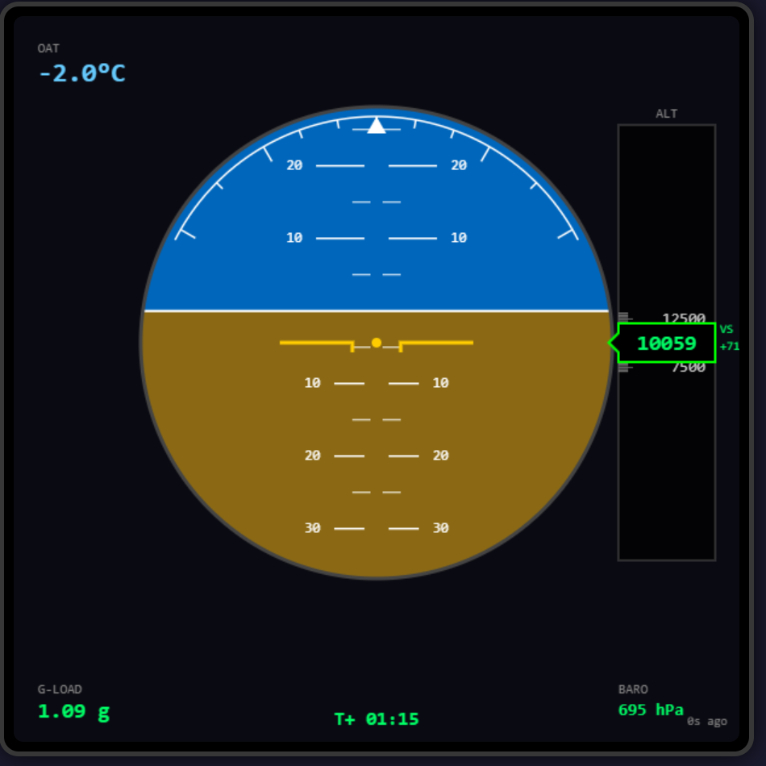
//
REFERENCE IMPLEMENTATION
What a working solution looks like
Hardware
Embedded
Backend
Frontend
real or simulated
tiny-RTOS
Flight-data logic
Reads in real time
Secondary Flight Display — frontend output
System components and data flow
Notes:
Show the reference SFD and walk through how the three components talk to each other.

Slide 5
//
GO FURTHER
Extend it with real hardware
Once your core pipeline runs end-to-end, plug in a physical input device for an extra challenge.
01
STM32: flash your logic onto a real embedded target.
02
Gamepad: analog stick input for finer control.
03
Mouse & Keyboard: the reliable baseline, always available.
Notes:
Optional stretch goals for teams who finish early.

Slide 6
//
AI SETUP
Get the on-prem AI harness running on your machine
Three steps set up the AI tooling you will use during the hackathon. Do them before you start building.
More information: pi cockpit - João Pedro Simões - Confluence
01
SSH key: configure your Bitbucket SSH key.
02
LiteLLM key: generate one (login with SSO) at LiteLLM Dashboard
Team: Company Team
Key Name: whatever you want
03
Clone & run: git clone the repo, then run run.cmd / run.sh:
https://bitbucket.critical.pt/projects/AIACCELERATION/repos/criticalpiharness_gui/browse
Notes:
Optional stretch goals for teams who finish early.

Slide 7

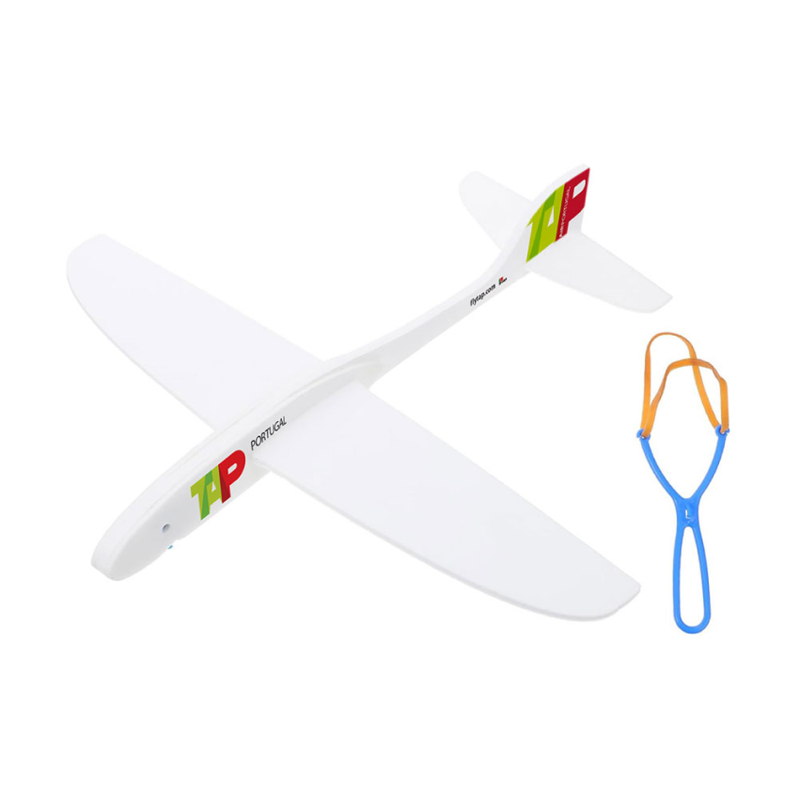

//
RECOGNITION
Prizes
01
02
03
First to Fly
Extra Mile
The Hive
First team to get a fully working solution up and running.
Built something beyond the brief - nobody asked, you did it anyway.
Best automated pipeline for integrating changes - features, scaling, and beyond.
Notes:
Run through what's up for grabs.

Slide 8
Good luck.
Demo & prizes at the end of the day.
Questions? Find your table lead.
Build something safety-critical, fast.
Notes:
Close and send teams off to start building.

